Slide 1
Semantic Collaboration Compass ——A Semantic SNS wiki
Group: Peiqin Gu, Chunying Zhou, Chao Wang, Zhipeng Peng
2011/09/30

Slide 2
Outline
Design goals
Vulcan SMW+ & ZJU sMash
Scenarios
Features
Technical Design
UI Design

Slide 3
Design Goals
Semantic Collaboration Compass (SCC) is a micro-wiki system that uses a combination of short posts, charts, tweets, online mash-ups, etc., which are delivered as mini-wiki-widgets, to support on-the-fly social collaboration.
It will be based on Vulcan’s Semantic MediaWiki Plus (SMW+) and Zhejiang University (ZJU)’s semantic mash-up engine (sMash).
Collaboration Compass
Semantic MediaWiki+
Wiki Widgets
Data Mashups
sMash
SNS Service

Slide 4
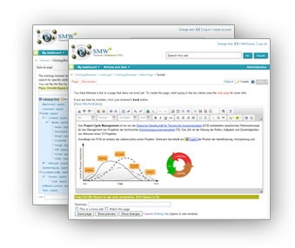
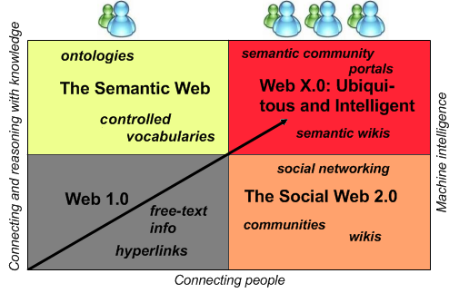
Vulcan SMW+
Semantic Enterprise Wiki
Integrate knowledge in a efficient, flexible and collaborative way
Open-source semantic wiki software that combines:
Wiki-style text/article authorship
Lightweight web-scale semantic publishing
Collaborative, user-governed subject models and data curation
Simple and extensible data models with easy import/export
A new tool for data publishing

Slide 5
Architecture
Application level SMW+
Queries
Results
Annotations
Triple Store Connector
OntoBroker
Ontology/
Rules
Semantic Facts
Relational Databases

Slide 6
List of compatible extension releases and other pre-requisites
Automatic Semantic Forms extension v1.2
Collaboration extension v1.4
Data Import extension v1.4.3
Gardening extension v.1.3.5
Access Control List release v1.5
Rich media extension v1.5.2
Rule knowledge extension v1.2.3
Semantic Forms v2.1.2
Semantic Forms Inputs v0.4.1
Semantic Notifications 1.2
Semantic Result Formats v1.5.3
Semantic tree view extension v1.4.4
Widgets extension v0.9.2
Project Management bundle v1.2
New User Message v3.0

Slide 7
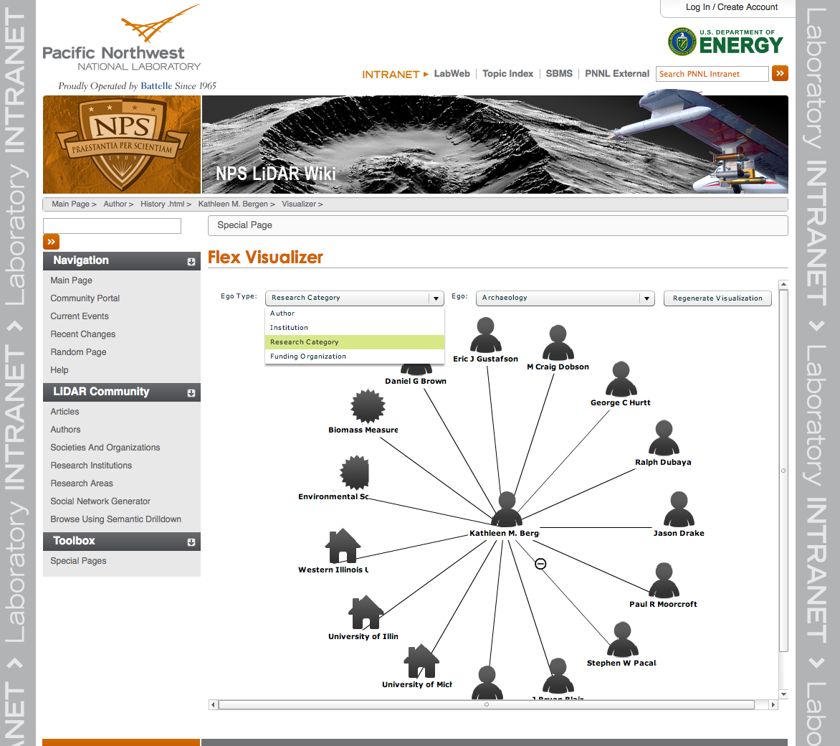
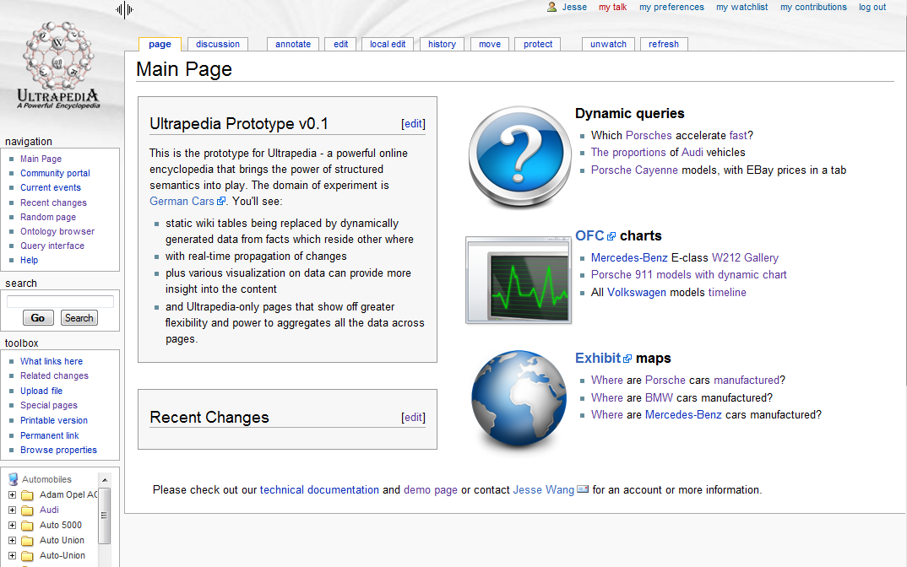
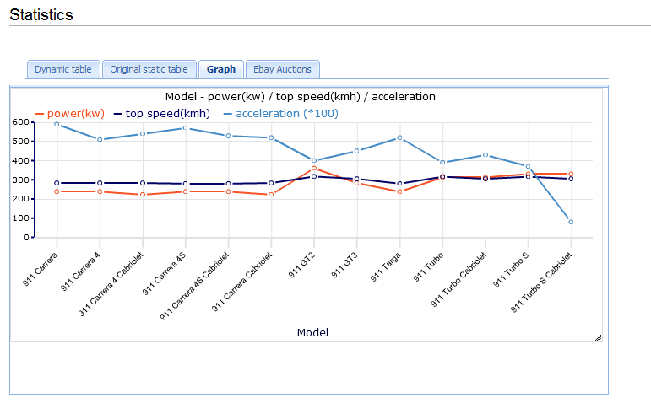
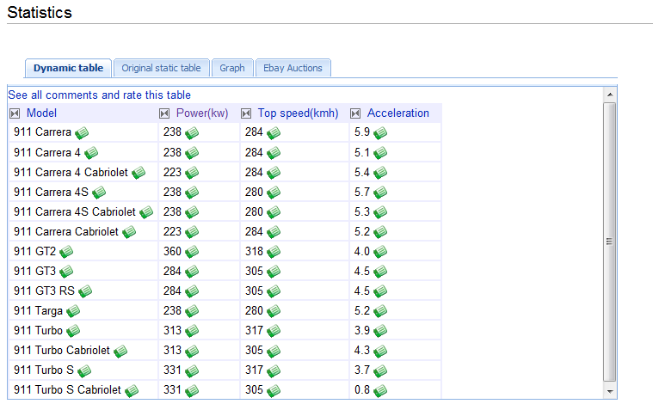
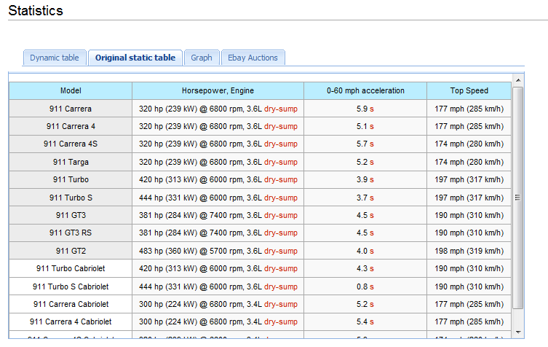
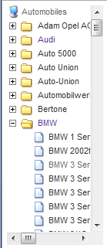
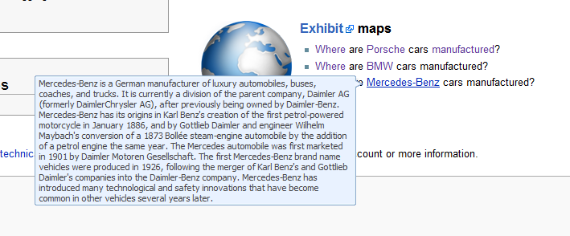
Cases

Slide 8
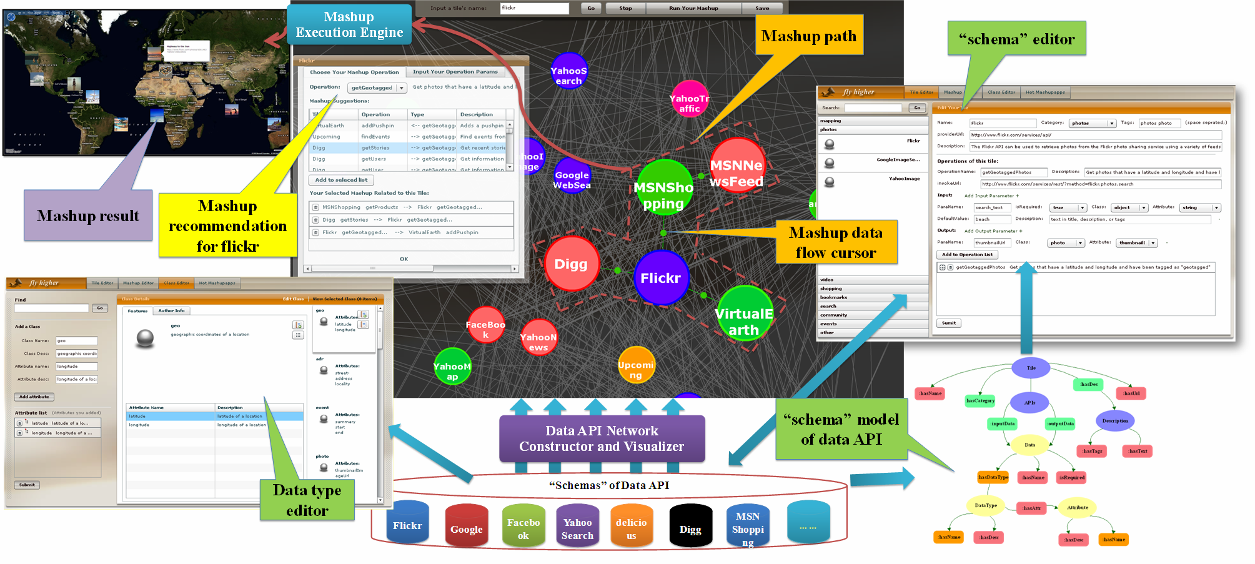
SMash in ZJU
Bin Lu,Zhaohui Wu, Yuan Li, Guotong Xie, Chunying Zhou, Huajun Chen. Smash: Semantic-based Mashup Navigation for Data API Network. WWW 2009.
Mashups enables users with little or no technical background to create customized applications.
Procedures
Data collection
Schema editor, microformats, data type editor
Data API network construction and visualization
Discover loosly links.
Remove the meaningless loosely links.
Visualize the network in the form of graph.
Mashup candidate recommendation

Slide 9
sMash architecture

Slide 10
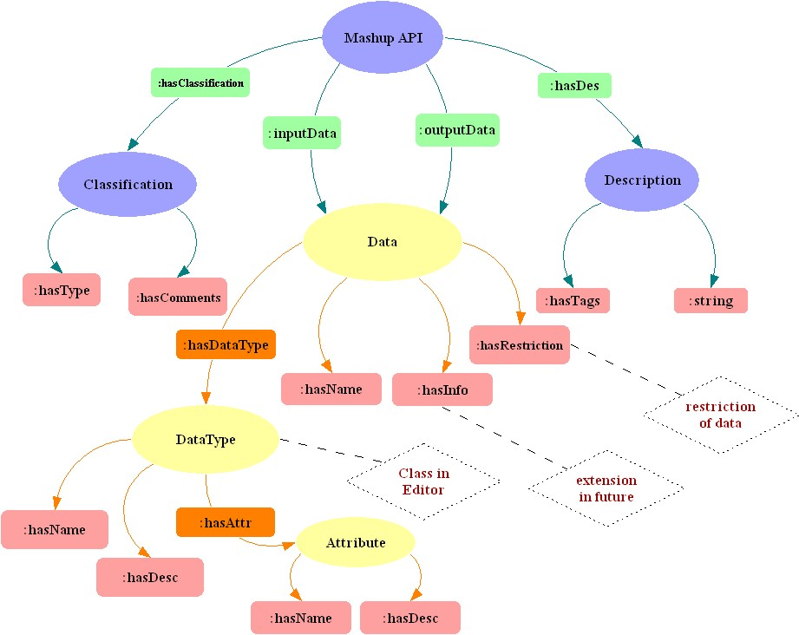
Key technologies: network construction

Slide 11
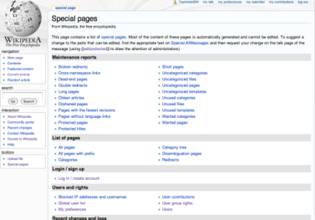








Scenario 1: SNS online shopping
Semantic Wiki
“G14 mobile Group-buying”
Create wiki page
Manage widgets
topic creator
Invite friends
Mashup engine
G14 mobile
Filter
Detail information
Comments
@this plan
Purchase
SNS widget
Microblog widget
Group buying widget
Comment widget
Digital device widget

Slide 12
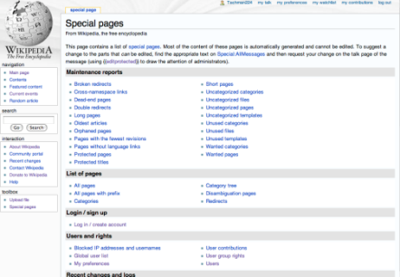




Scenario 2: Trip planning
Semantic Wiki
“Huangshan Trip plan”
Create wiki page
Manage widgets
topic creator
Invite friends
Mashup engine
Huangshan
Filter
Ticket information
Weather
Photos
@this plan
Schedule
SNS widget
Micro blog widget
Calendar widget
Weather widget
Photo widget
Ticket
Service widget

Slide 13
Features
Serves smaller social circles for more focused, transient, and/or recurring topics such as a “Hawaii vacation plan” instead of big domains, e.g. biology encyclopedia.
It offers mini-wiki-widgets to let users create editable, annotatable micro-contents such as email, tweets, mashups, charts, streams etc. instead of a whole page or just links.
Wiki widgets can be built upon online mash-ups and data importers, and the content can be auto synchronized.
Mashups are annotated and composited semantically, which have mappings to wiki ontologies so data can be easily imported into semantic wiki.
Popular Social Networks Services networks such as Facebook, Twitter, LinkedIn, will be natively supported.
Users will be able to collaborate through the web interface, email, SNS and mobile applications.

Slide 14
Features
Authoring and editing
Querying and Searching
Organizing and curating
Integrating and exchanging

Slide 15

Technical Design
…
Families, Enterprises, Interest Groups…
Compass Portal
Feed, News Wikidget
Photo Wikidget
Event Wikidget
Media Wikidget
Database Wikidget
…
Custom View
Collabration Compass System
Wiki Bundle Portal Creation Tool
Wikidget Configuration Tool
Wikidget Data Importing Tool
Wikidget Repository
Wiki Bundle Templates Repository
Subject
Filtering
Topic
Aggregation
Knowledge
Extraction
Data
Visualization
Semantic Mash-up Engine
Recommendation
Composition
Integration
News Mashup
Social Mashup
Location Mashup
Event Mashup
…
Music Mashup
Photo Mashup

Slide 16
Bridging sMash and SMW
Create extensions to SMW
Dynamic Wiki Bundle creation UI and layout
API-based widget template
Semantic Wiki Data import UI
Wikidget Configuration Tool
Wikidget Template Repository
Bundle Portal Template Repository
Extend sMash to deal with API discovery and huge amounts of APIs
Automatic API discovery
Repository management
Network construction
Trace-based recommendation
Behavior-based recommendation
Automatic Filter construction

Slide 17
Portal original
User control
TITLE: Huangshan Trip Planning
Creator:John
Collaborator:
Amy
Jack
Widget List
Category:
Utility
Travel
Shopping
Food
Widget layout

Slide 18
Detailed portal
User control
TITLE: Huangshan Trip Planning
Creator:John
Collaborator:
Amy
Jack
Micro blog post wall
Map
Travel information
Widget List
Category:
Utility
Travel
Shopping
Food
Airline information
Comments

Slide 19
SNS configuration
Invite friends
Invite friends
Invite friends
Invite friends
Posts update
Posts update

Slide 20
Widget configuration (1)
Widgets
Style
Layout
Life
Art
Nature
Project
Shopping
Work plan
Calendar
Group buying widget
Comment widget
Digital device widget
Sales widget
Chosen widgets: …
OK
Cancel

Slide 21
Widget configuration (2)
Widgets
Style
Layout
××
style
××
style
××
style
××
style
××
style
××
style
××
style
××
style

Slide 22
Widget configuration (3)
Widgets
Style
Layout

Slide 23
Semantic SNS Wiki is a nutshell
It is a wiki: Platform for web-based collaboration and quick authoring and provision of content.
It is a database: Users embedded data in text that can be retrieved with powerful data query mechanisms.
It is a template repository: Users manage and use APIs through UI.
It is a data integration tool: Users access data from external databases, web services or the Semantic Web from within the Wiki.
It is targeted to small social circles: Users invite friends to participate in web activities.

